Slide 1
My hotel
Ian andika d.s
Muhamad hudya ramadhana
Mutia ayu dianita

Slide 2
background

Slide 3
System analysis

Slide 4
Data structure
- array

Slide 5
algorithm
LINEAR SEARCH
BUBBLE SORT

Slide 6
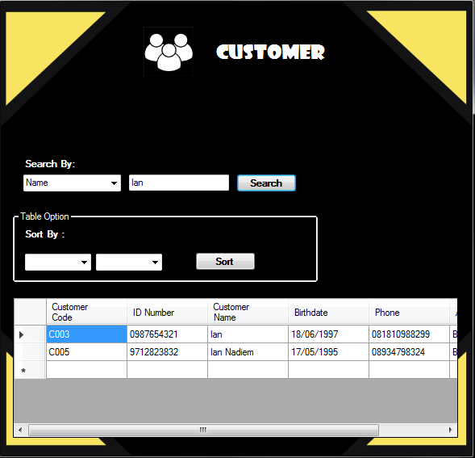
Linear Search

Slide 7
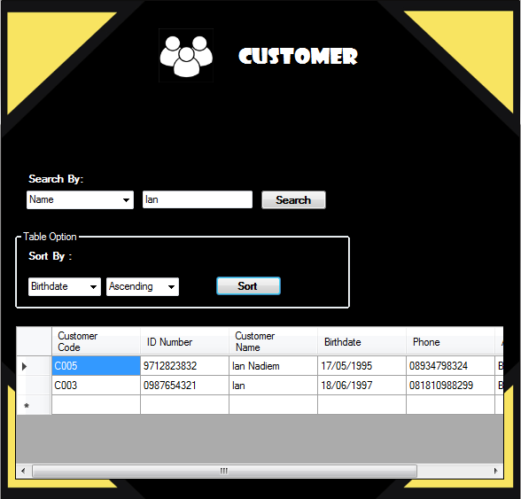
Bubble Sort

Slide 8
FORM WITH ALGORITHM
CUSTOMER Display
Transaction Display
Room Display
Class Display

Slide 9
Thanks!
Any questions?

